Slide 2
AGENDA
Drug Development Process
Importance of Clinical Trials
Phases of clinical trials
- Laboratory studies
- Pre-clinical
- Phases I, II, III
- Post-Marketing Surveillance

Slide 3
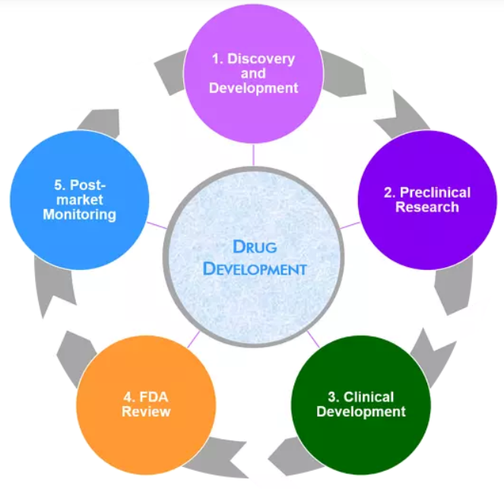
Drug Development Process
Importance of Clinical Trials
“Clinical research” refers to studies, or trials, that are done in people
The ultimate goal of drug development is to bring a new compound with proven therapeutic effect to the market
Transition from preclinical research to clinical stages marks a critical turning point, as it nears the new medicinal product to the market

Slide 4
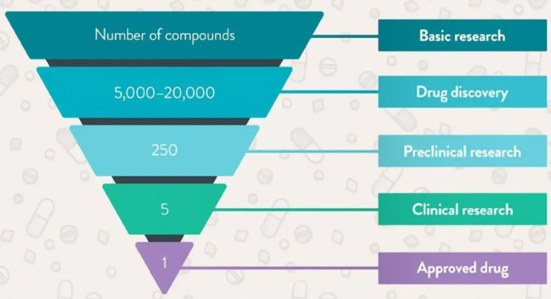
Drug Development Process
Importance of Clinical Trials
Of every 5,000 new molecules identified in the laboratory, about 250 will enter pre-clinical testing
Of this 250, fewer than 10 are tested in clinical trials
On average only one will be approved by regulatory authorities

Slide 5
Drug Development Process
Importance of Clinical Trials
Phase I
30% to 50%
Phase II
40% to 70%
Phase III
20% to 50%
Number of unsuccessful clinical trials has been steadily increasing during the last years
Akhondzadeh S , Malek-Hosseini M , Ghoreishi A , et al. Effect of ritanserin, a 5HT2A/2C antagonist, on negative symptoms of schizophrenia: a double-blind randomized placebo-controlled study. Prog Neuropsychopharmacol Biol Psychiatry 2008; 32 (8): 1879– 1883.

Slide 6
Drug Development Process
Phases of Clinical Trials
3-6 years
6-7 years

Slide 7
Drug Development Process
Phases of Clinical Trials- Laboratory Studies
In vivo studies
Laboratory phase
Preclinical
Phase l, II, III
Stages of drug discovery and development at the laboratory phase
Target identification
Target validation
Lead identification
Lead optimization
Product characterization
Formulation and development

Slide 8
Drug Development Process
Phases of Clinical Trials- Laboratory Studies
Target Identification | Target Validation | Lead Identification | Lead Optimization | Product Characterization | Formulation and development
The first step in the discovery of a drug is identification of the biological origin of a disease, and the potential targets for intervention | Process by which the expected molecular target – for example gene, protein or nucleic acid of a small molecule is certified | Synthetically stable, feasible, and drug like molecule active in primary and secondary assays with acceptable specificity, affinity and selectivity for the target receptor | Process by which a drug candidate is designed after an initial lead compound is identified | When any new drug molecule shows a promising therapeutic activity, then the molecule is characterized by its size, shape, strength, weakness, use, toxicity, and biological activity | Pharmaceutical formulation is a stage of drug development during which the physicochemical properties of active pharmaceutical ingredients (APIs) are characterized to produce a bioavailable, stable and optimal dosage form for a specific administration route
Starts with isolating the function of a possible therapeutic target (gene/nucleic acid/protein) and its role in the disease | Process of demonstrating the functional role of the identified target in the disease | A drug ability assessment is often conducted in order to decrease the number of compounds that fail in the drug development process | The purpose of lead optimization is to maintain favorable properties in lead compounds
Identification of the target is followed by characterization of the molecular mechanisms addressed by the target | To demonstrate that the target is involved in the progression of a given disease and that its activity can be regulated | Bind to a specific target; however, also important is the compounds pharmacokinetic profile compound‘s pharmacokinetic profile regarding absorption, distribution, metabolism, and excretion | Optimized for efficacy and safety. The design of synthetic molecules can be altered to prevent off-target binding, making them less likely to interact with molecules other than the target

Slide 9
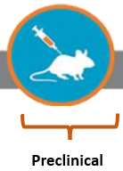
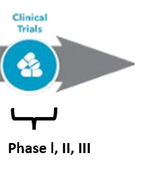
Drug Development Process
Phases of Clinical Trials- Post laboratory phase
Investigational new drug (IND)
New drug application (NDA)
Marketing
Pharmacovigilance
It takes an average investment of about US $1 billion from discovery to the approved medicine

Slide 10
Drug Development Process
Phases of Clinical Trials- Pre clinical testing
Pre-clinical research involves evaluation of drug‘s efficacy, toxicity, and pharmacokinetic information in animal species that conclude to prospective human outcome
Determine the following about the drug
Absorption, distribution, metabolization, and excretion information
Potential benefits and mechanisms of action
Best dosage, and administration route
Side effects/adverse events
Effects on gender, race, or ethnicity groups
Interaction with other treatments
Effectiveness compared to similar drugs

Slide 11
Drug Development Process
Phases of Clinical Trials- Investigational New Drug Process (IND)
Drug developers must file an Investigational New Drug application to FDA before commencement clinical research on humans
In the IND application, developers must include:
• Preclinical and toxicity study data
• Drug manufacturing information
• Clinical research protocols for studies to be conducted
• Previous clinical research data (if any)
• Information about the investigator/ developer

Slide 12
Drug Development Process
Phases of Clinical Trials- Phase I, II, III
Phase I | Phase II | Phase III
First tests of a drug with a lesser number of healthy human volunteers. Evaluate safety and dosage | Evaluate the efficacy of the drug and to endure the Phase I safety assessments | To prove whether a product deals an action benefit to a specific people or not. More probable to detect long-term or uncommon side effects
20 to 80 healthy volunteers with the disease/condition | Few hundred (100-500 patients with the disease or condition) who may receive a placebo or standard drug previously used as treatment | Usually conducted in few hundreds to thousands (300 to 3,000 volunteers with the disease or condition)
Adjust dosage regimen based on animal study data to find out what dose of a drug can tolerate the body and what are its acute side effects Length time: Several months | Several months to 2 years | 1 to 4 years
Imperative to the design of Phase 2 studies. Almost 70% of drugs move to the next phase | Aid to find therapeutic doses for the large-scale Phase III studies. Around 33% of drugs move to the next phase | Around 25-30% of drugs travel to the next phase

Slide 13
Drug Development Process
Phases of Clinical Trials- New Drug Application (NDA)
A New Drug Application (NDA) expresses the full story of a drug molecule. Its purpose is to verify that a drug is safe and effective for its proposed use in the people studied
A drug developer must include all about a drug starting from preclinical data to Phase 3 trial data in the NDA. Developers must include reports on all studies, data, and analysis
Beside with clinical trial outcomes, developers must include:
• Proposed labeling
• Safety updates
• Drug abuse information
• Patent information
• Directions for Use

Slide 14
Drug Development Process
Phases of Clinical Trials- Post marketing/Pharmacovigilance
Conducted when the drug or device has been approved by FDA
Continue technical support after approval
Required by regulatory authorities (e.g. change in labelling, risk management/minimization action plan) or may be undertaken by the sponsoring company for competitive purposes or other reasons
True illustration of a drug‘s safety essentially requires over the months and even years that mark up a drug‘s lifespan in the market

Slide 15
Drug Development Process
Preclinical study reports
Pre-clinical sections of INDS
Clinical sections of INDs
Clinical development plans
Investigator’s brochure
Exploratory protocol
CTD modules
Protocol
Investigator’s brochure
Informed consent form
Case report form (CRF)
Clinical study report (CSR)
Manuscript
Abstract and Posters
Periodic safety update reports (PSUR’S)
Product monographs
Post marketing surveillance studies (PMS)
Aggregate reports
Real world evidence (RWE)/ Observational

